Slide 1
Musical Instrument Classification Using a Hybrid Neural Network
Landon Buell
Senior, Physics B.S. Major
University of New Hampshire
8 Jan 2020
Kevin Short
University Professor & Professor of Mathematics
Founder, Integrated Applied Mathematics Program
University of New Hampshire

Slide 2
Introduction

Slide 3
Presentation Outline
Introduce the problem that we are going to solve
Develop Neural Networks as the solution
Discuss consequences and improvements to the solution
Analyze the performance of the improvements

Slide 4
Mapping Sounds to Sources
Humans are proficient at mapping sounds to sources
Impractical at a large scale
Computers are not proficient at mapping sounds to sources
Can handle large volumes of data

Slide 5
“Birds inspired us to fly, burdock plants inspired Velcro and nature has inspired many other inventions. It seems only logical then, to look to the brain’s architecture for inspiration on how to build an intelligent machine.”
- Aurelion Geron, Former YouTube Video Classification lead

Slide 6
The Neural Network

Slide 7
Structure
Consider a neural network to be just like a mathematical function
Composed of smaller functions called layers
Transform features into predictions

Slide 8
Classification Model
Inputs are properties of digital audio files from London’s Philharmonia Orchestra and University of Iowa’s Electronic Music Studios
Outputs are integers that correspond to musical instruments
We group samples with similar input properties

Slide 9



The Multilayer Perceptron (MLP)
Connect Layers of artificial neurons
Each neurons contains a value called its activation
${\vec{x}}^{(l)}$ =
$W^{(l)}$
${\vec{x}}^{(l−1)}$

Slide 10
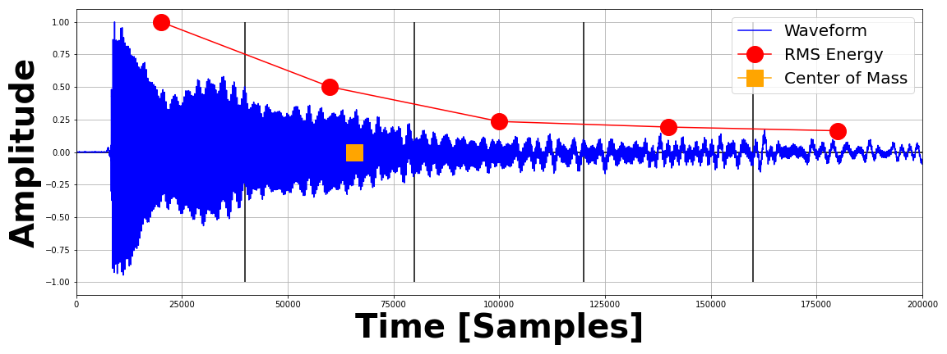
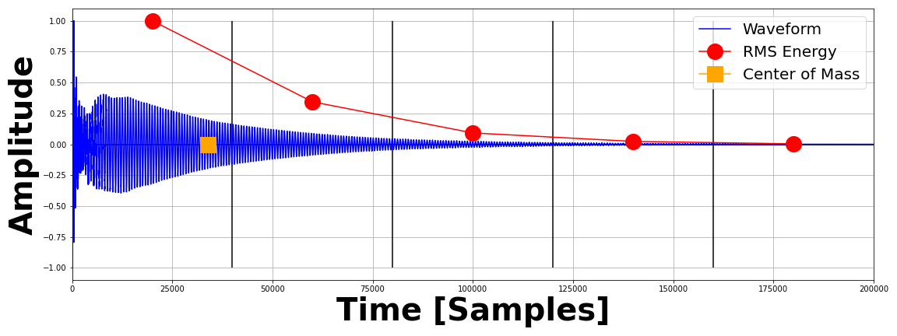
Features for the MLP
Time Domain Envelope (x5)
Zero Crossing Rate
Temporal Center of Mass
Auto Correlation Coefficients (x4)
Mel Frequency Cepstrum Coefficients (x12)
Frequency Center of Mass

Slide 11
Features for the MLP
Time Domain Envelope (x5)
Zero Crossing Rate
Temporal Center of Mass
Auto Correlation Coefficients (x4)
Mel Frequency Cepstrum Coefficients (x12)
Frequency Center of Mass

Slide 12









The Convolutional Network (CNN)
Convolve over 2D input to detect characteristic features
Consider an image as a 2D grid of neurons with activations
Pass a weight kernel over the image to “scan” features
$${\vec{x}}^{(l−1)}$$
$$W^{(l)}$$
$$\sum_{u}{\sum_{v}{}}$$
${\vec{x}}^{\left(l\right)[i,j]}$=
$$W^{(l)}$$
$$[i,j]$$
$${\vec{x}}^{(l−1)}$$
$$[i−u,j−v]$$
$${\vec{x}}^{(l)}$$

Slide 13
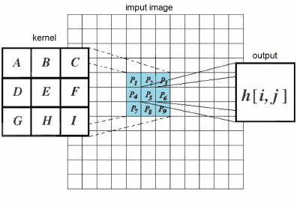
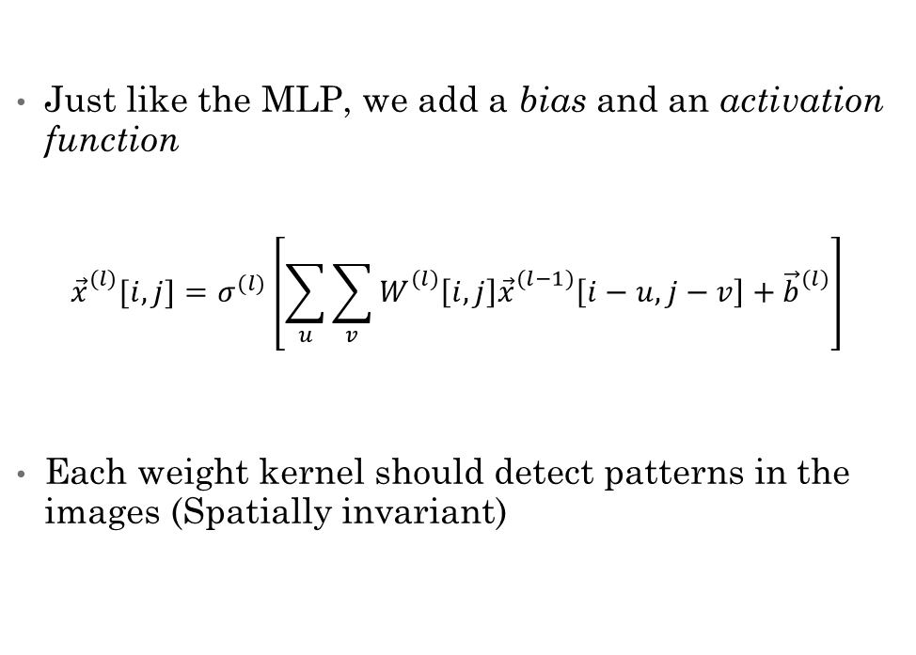
The Convolution Operation
Just like the MLP, we add a bias and an activation function
$${\vec{x}}_{}^{(l)}[i,j]=σ^{(l)}\left[\sum_{u}{\sum_{v}{W_{}^{(l)}\left[i,j\right]{\vec{x}}_{}^{(l−1)}\left[i−u,j−v\right]+{\vec{b}}_{}^{(l)}}}\right]$$
Each weight kernel should detect patterns in the images (Spatially invariant)

Slide 14


The Pooling Operation
Return largest activation in 2D grouping
Ensures only the most prolific features are preserved
Typically used after a convolution layer
Reduces size of arrays, number of parameters
$${\vec{x}}^{(l−1)}$$
$${\vec{x}}^{(l)}$$

Slide 15


The Flattening Operation
Transforms 2D grid of neurons to a 1D row/col of neurons
Allows images to be passed into dense layers
$${\vec{x}}^{(l−1)}$$
$${\vec{x}}^{(l)}$$

Slide 16
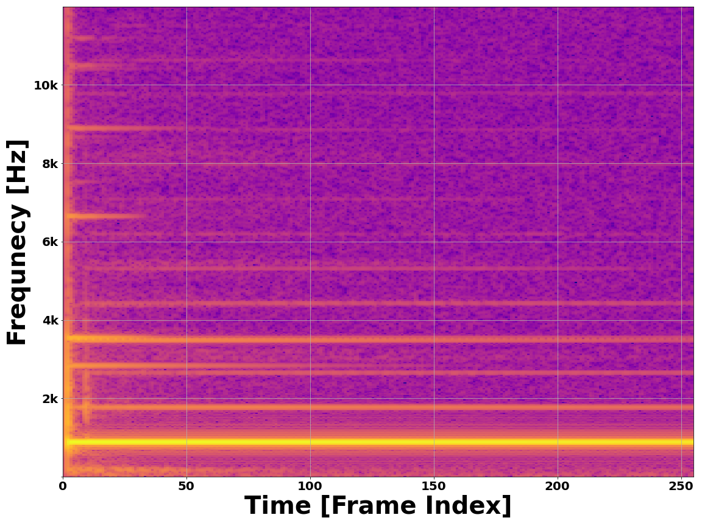
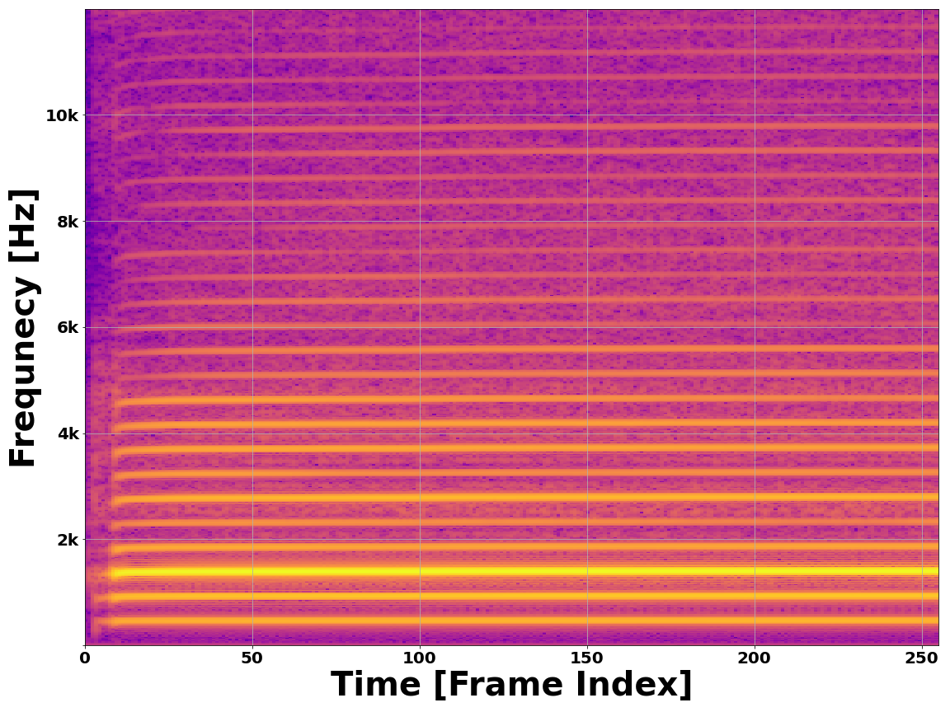
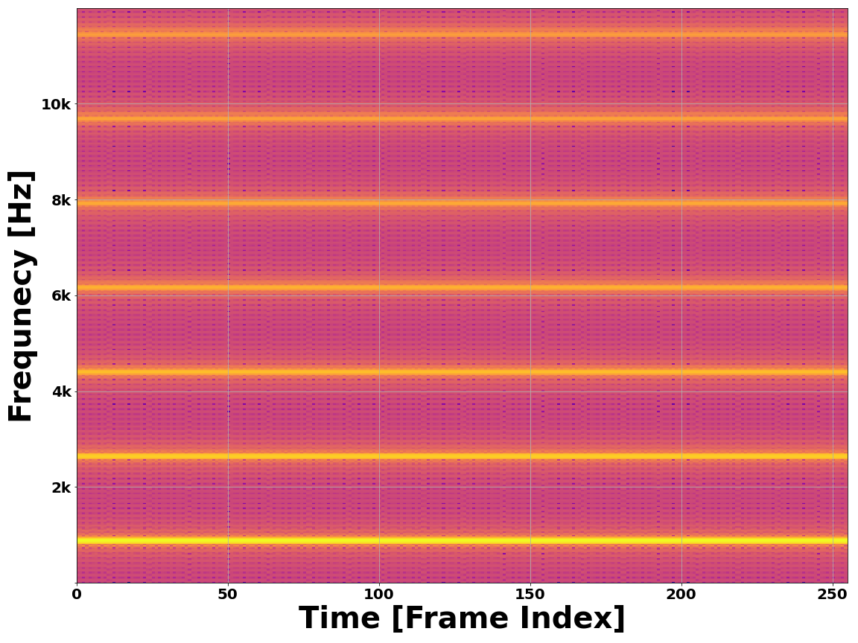
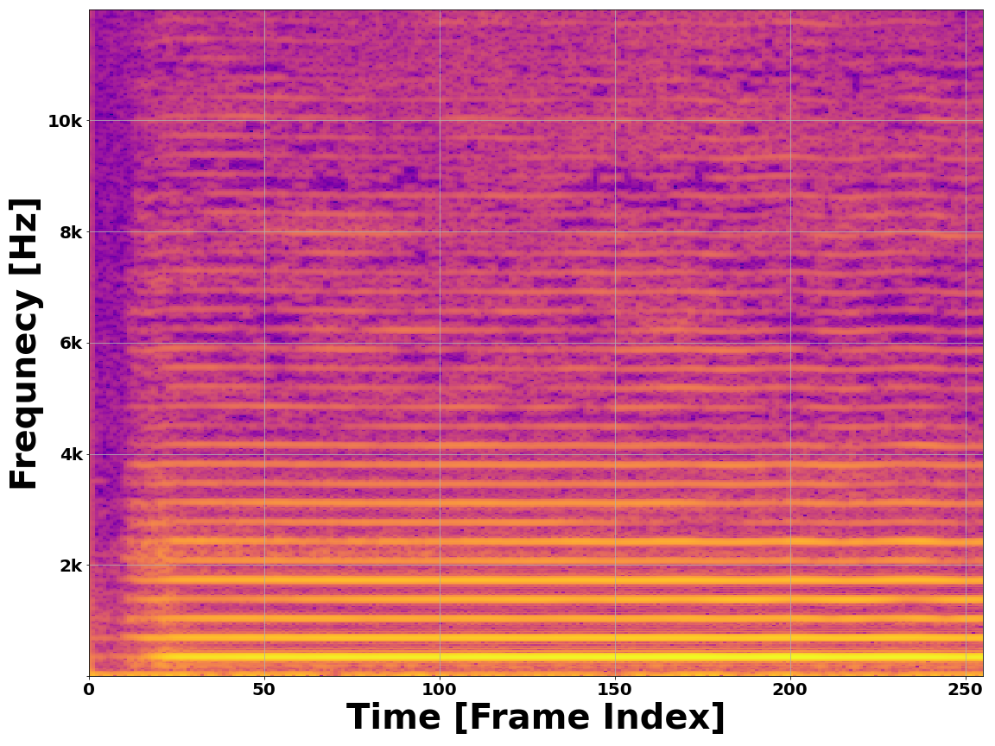
Features for the CNN
Vibraphone - A5
Oboe – Bb4
Square Wave - A5
Cello – F4

Slide 17
Consequence of the Solutions
Both architectures have experimentally shown individual success
MLP and CNN use different forms of inputs that are initially incompatible
We can combine them to form a Hybrid Neural Network
Connections made at hidden layer where representations are 1D

Slide 18
Hybrid Network Architecture

Slide 19
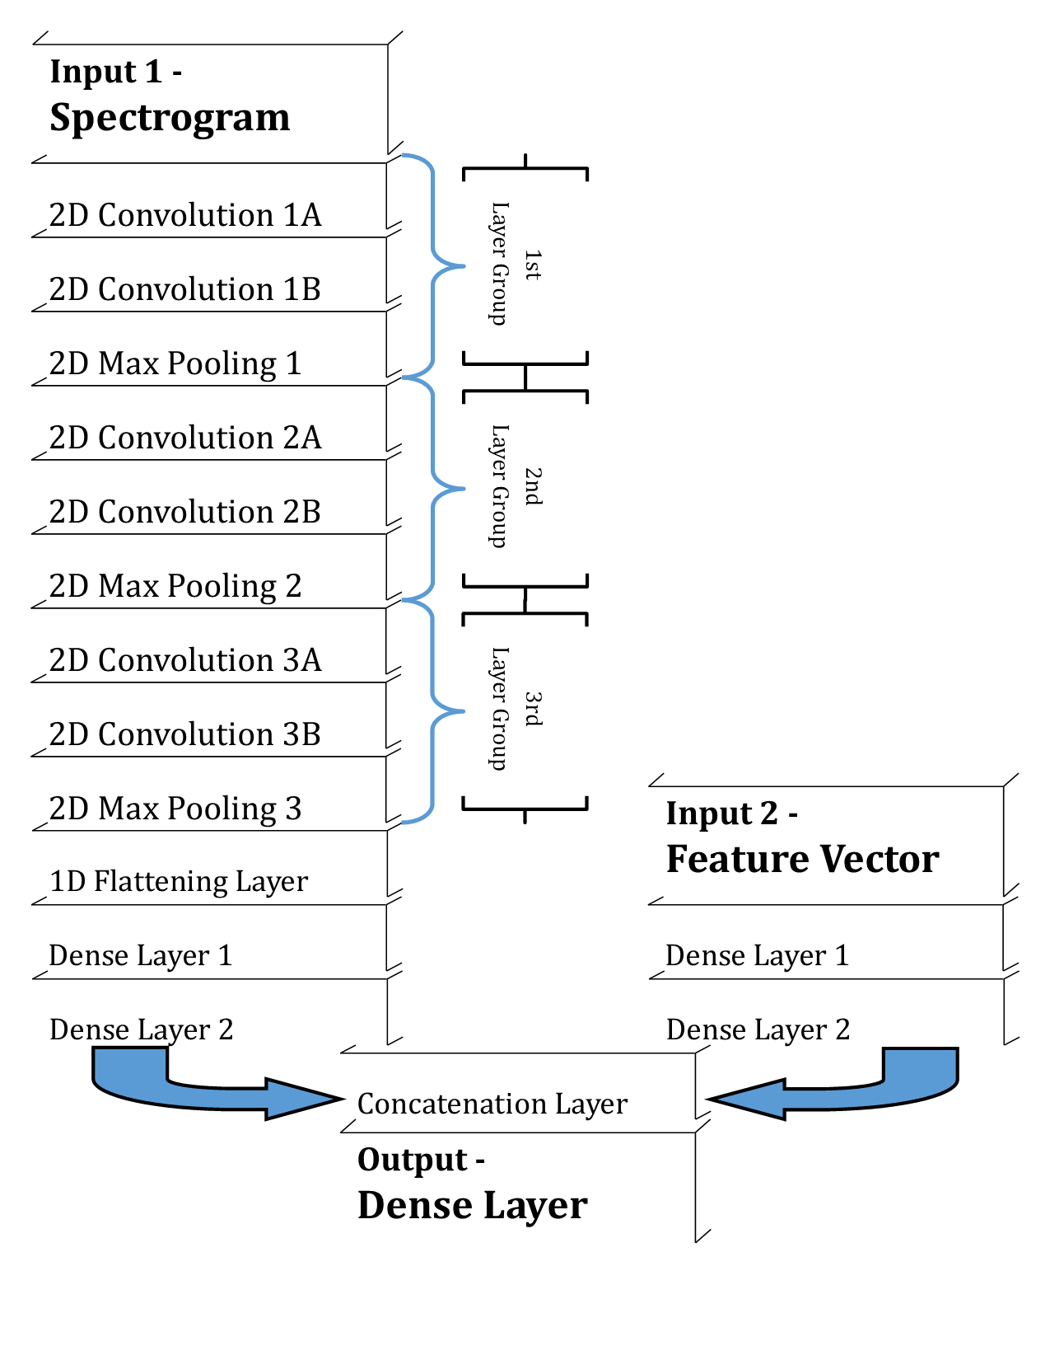
Hybrid Neural Network Architecture

Slide 20
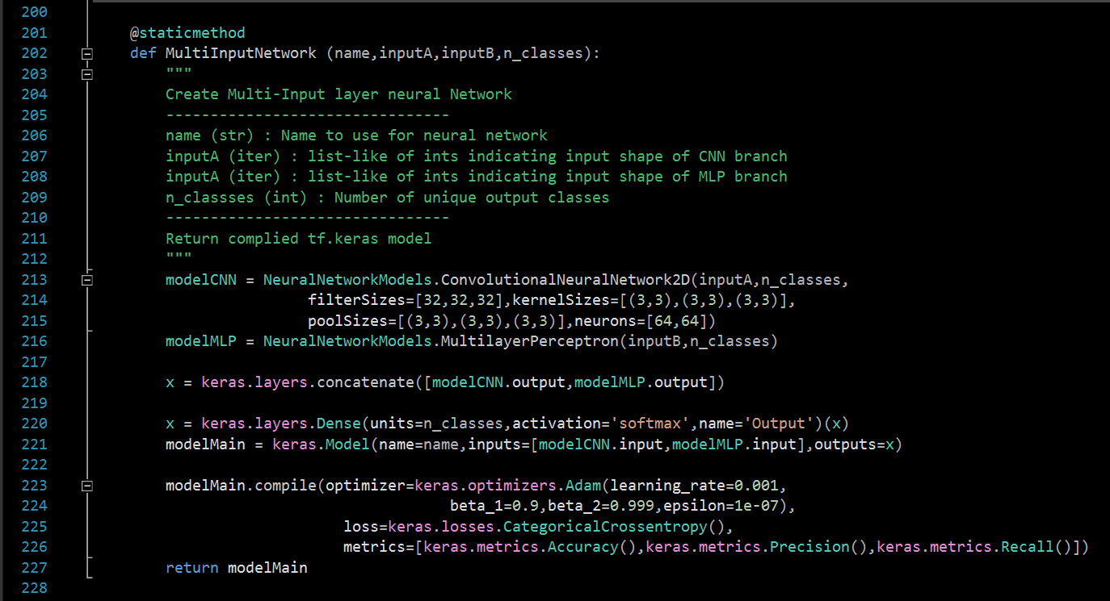
Implementation (Tensorflow.keras)
Create each input Branch as its own model
Concatenation of each model’s output activations
Create combined output layer, wrap as single model instance
Compile the model, prepare for training/testing
Return the hybrid network instance

Slide 21
This is called Multimodal Deep Learning
Transform incompatible inputs to a compatible format at an internal layer

Slide 22
Performance of the Hybrid Model

Slide 23
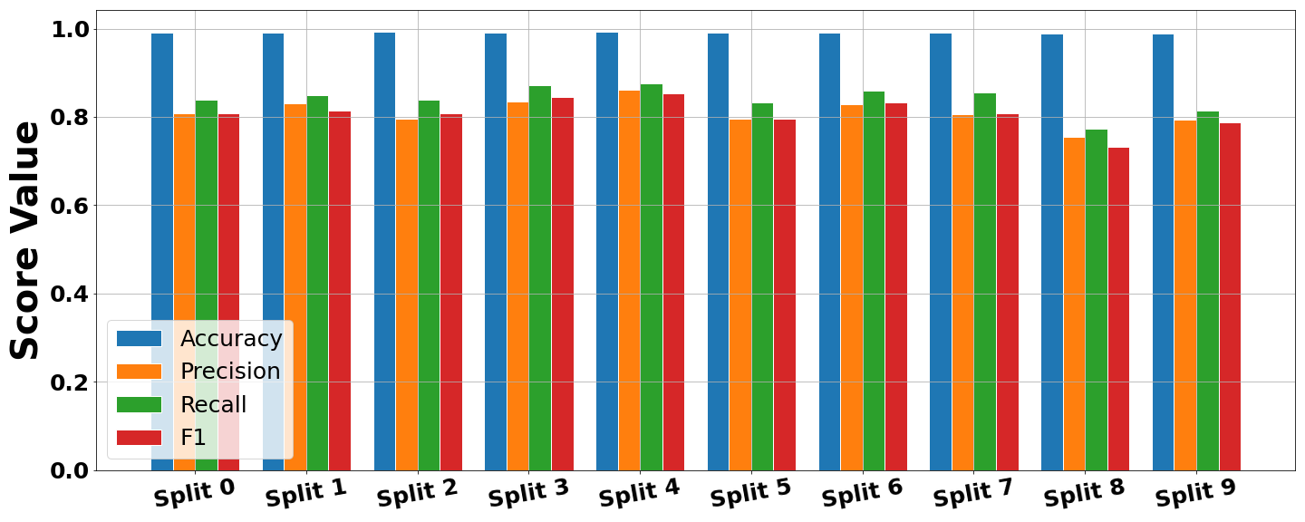
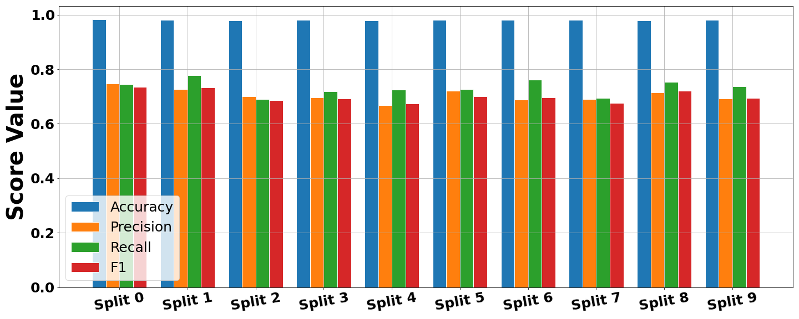
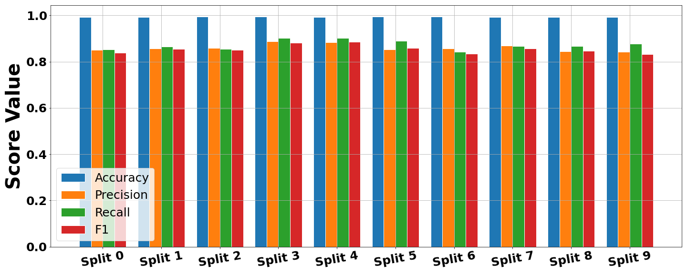
X-Validation Performance
1)
Compare three variants
CNN Architecture
MLP Architecture
Hybrid Architecture
Hybrid network shows generally higher and more consistant performance scores
2)
3)

Slide 24
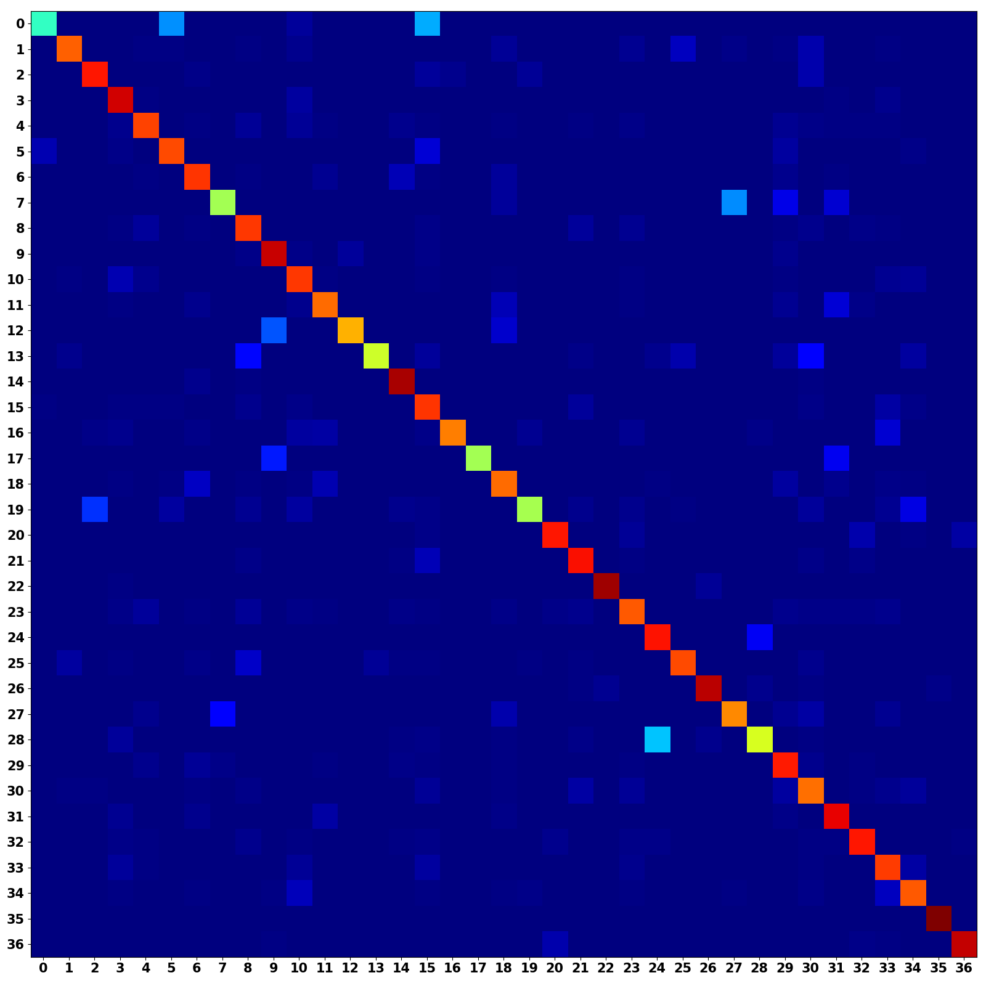
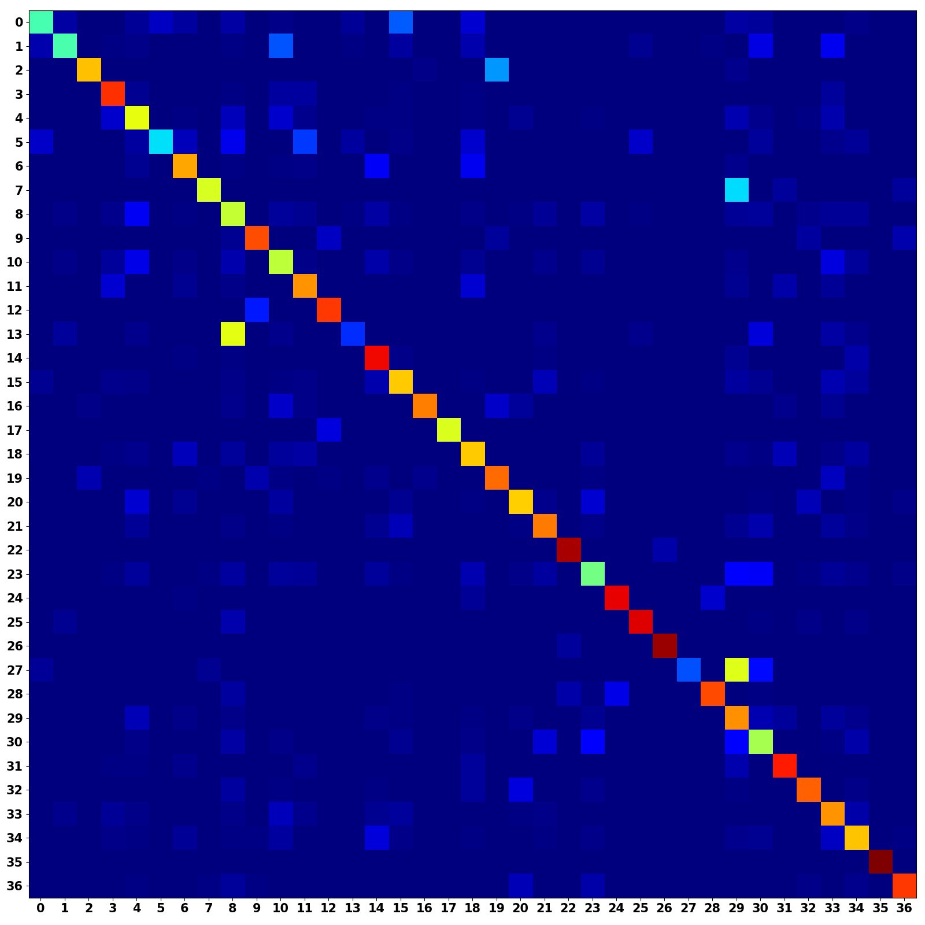
Unimodal Confusion Matrices
CNN Branch (Occurrence Weighted)
MLP Branch (Occurrence Weighted)
Frequent misclassifications
Strong main diagonal, reasonable performance
Related classes?
Poor features choice?

Slide 25
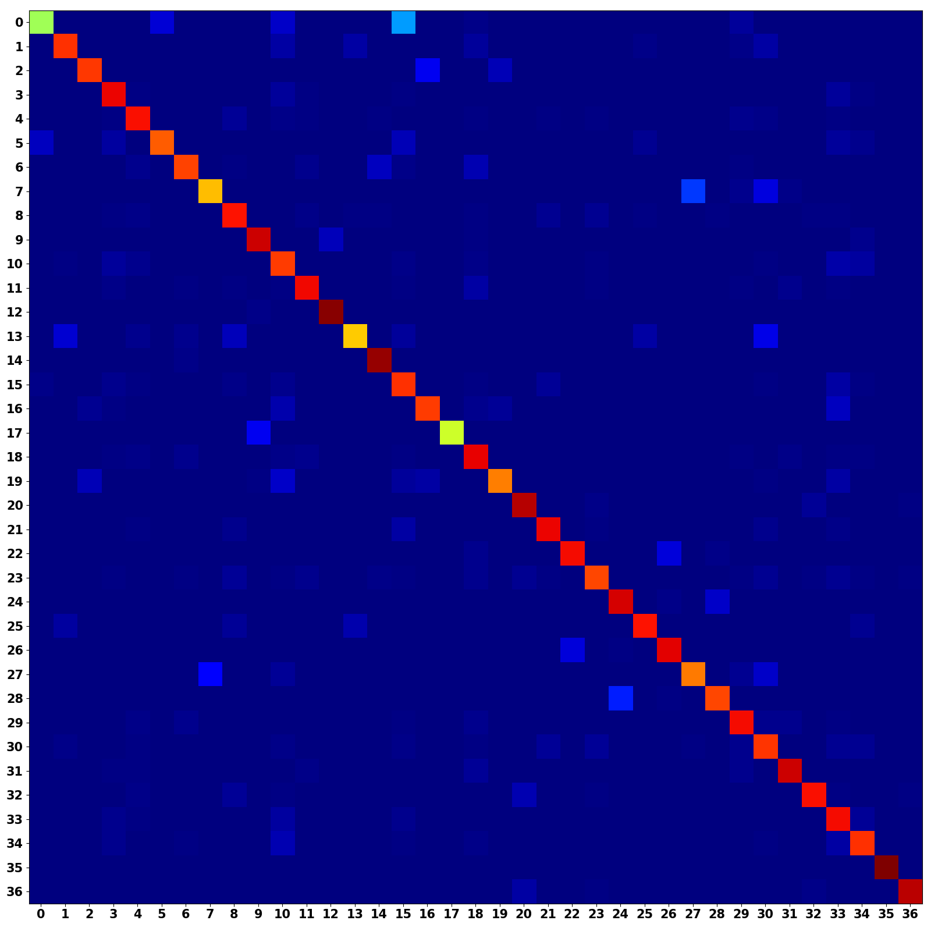
Multimodal Confusion Matrix
CNN + MLP (Occurrence Weighted)
Multimodal models shows a stronger main diagonal
Combines predictive power from both architectures

Slide 26
Discussion
Hybrid networks allows for multimodal learning
Transform into compatible formats
Opens the door to other related classification tasks
Many uses outside digital audio recognition
Cardiograph + Biometric readings
Speech + text information
Video + Audio

Slide 27
Conclusions
The hybrid network shows improved classification performance over either unimodal model
Possibility to generalize to other related tasks

Slide 28
Citations
[1] Geron, Aurelien. Hands-on Machine Learning with Scikit-Learn and TensorFlow: Concepts, Tools, and Techniques to Build Intelligent Systems. O’Reilly, 2017.
[2] Goodfellow, Ian, et al.Deep Learning. MIT Press, 2017.
[3] Khan, M. Kashif Saeed, and Wasfi G. Al-Khatib. “Machine-Learning Based Classification of Speech and Music.” Multimedia Systems, vol. 12, no. 1, 2006, pp. 55–67., doi:10.1007/s00530-006-0034-0.
[4] Li, Yingming, and Ming Yang. “A Survey of Multi-View Representation Learning.” Journal of LateX Class Files, vol. 14, no. 8, Aug. 2015.
[5] Liu, Zhu, et al. ”Audio Feature Extraction and Analysis for Scene Segmentation and Classification.” Journal of VLSI Signal Processing, vol. 20, 1998, pp. 61–79.
[6] Ngiam, Jiquan, et al. ”Multimodal Deep Learning.” 2011.
[7] TensorFlow: Large-scale machine learning on heterogeneous systems, 2015. Software available from tensorflow.org.
[8] Virtanen, Tuomas, et al. Computational Analysis of Sound Scenes and Events. Springer, 2018.
[9] White, Harvey Elliott, and Donald H. White. Physics and Music: the Science of Musical Sound. Dover Publications, Inc., 2019.

Slide 29
Thank you very much! Questions?
Additional information, GitHub Repository, and Formal Write-Up is Available upon request
Landon Buell – lhb1007@wildcats.unh.edu
Kevin Short – kevin.short@unh.edu

Slide 30
Appendix – Tensorflow / Keras
Free Python library centered around Deep Learning
High-Level API for constructing neural networks and computational graphs
Developed and maintained by Google
https://www.tensorflow.org/
Offers tools for hardware acceleration on certain GPUs

Slide 31
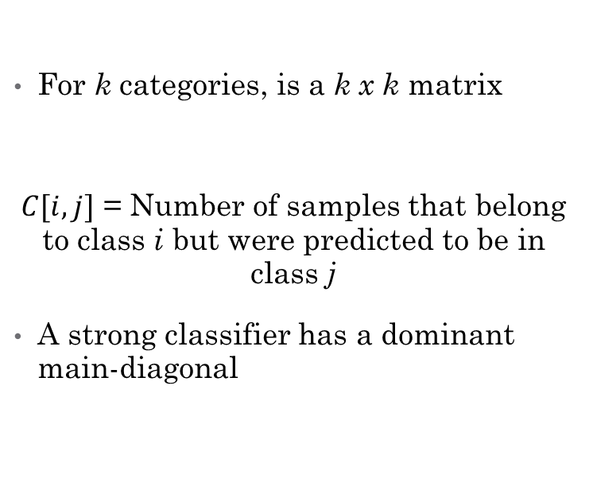
Appendix – Confusion Matrices
Standard Confusion Matrix
Occurrence Weighted Matrix
For k categories, is a k x k matrix
$C[i,j]$ = Number of samples that belong to class i but were predicted to be in class j
A strong classifier has a dominant main-diagonal
Created same as standard matrix
Divide each row by sum of the row
Accounts for non-uniform number of samples in each class

Slide 32
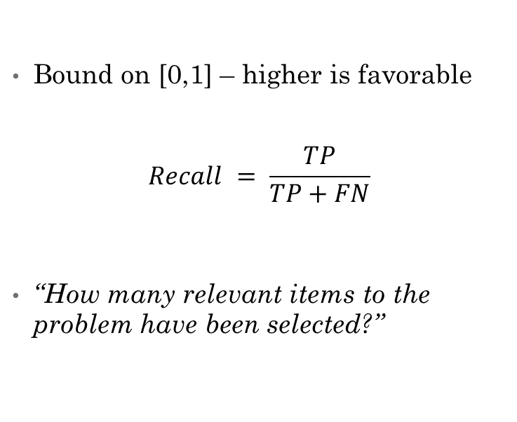
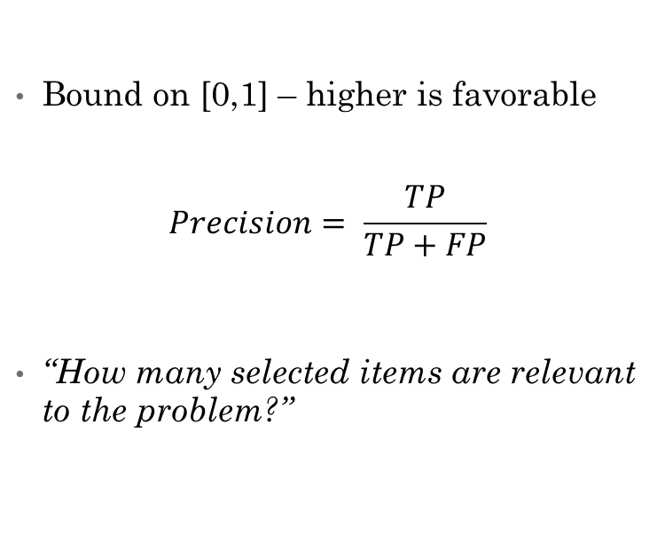
Appendix - Metrics
Precision / Specificity Score
Recall / Sensitivity Score
Bound on [0,1] – higher is favorable
$$Precision= \frac{TP}{TP+FP}$$
“How many selected items are relevant to the problem?”
Bound on [0,1] – higher is favorable
$$Recall = \frac{TP}{TP+FN}$$
“How many relevant items to the problem have been selected?”

Slide 33
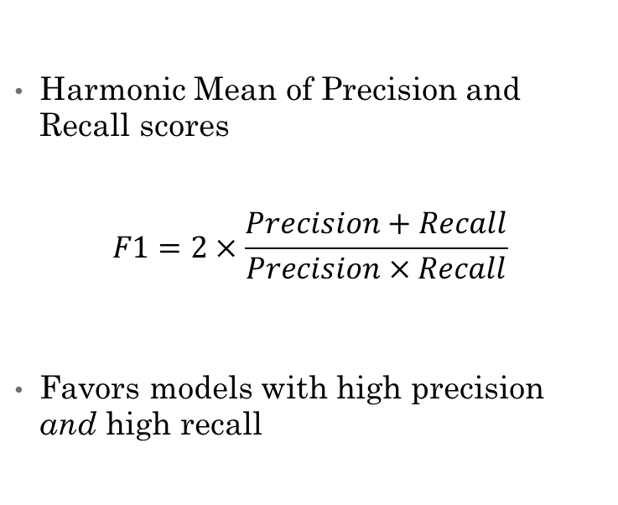
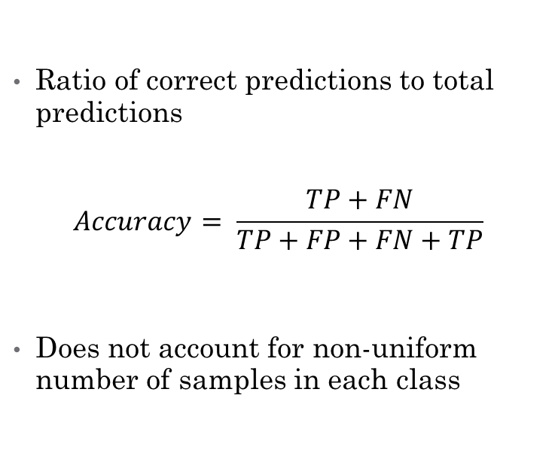
Appendix – Metrics (Cont.)
Accuracy Score
F1 Score
Ratio of correct predictions to total predictions
$$Accuracy= \frac{TP+FN}{TP+FP+FN+TP}$$
Does not account for non-uniform number of samples in each class
Harmonic Mean of Precision and Recall scores
$$F1=2×\frac{Precision+Recall}{Precision×Recall}$$
Favors models with high precision and high recall

Slide 34
Appendix – Musical Instrument Samples
University of Iowa Electronic Music Studios
University of Iowa Electronic Music Studios (uiowa.edu)
Philharmonia Symphony Orchestra
https://philharmonia.co.uk/
Samples preprocessed
WAV file format
44.1 kHz sample rate
Mono-channeled
16 bit-depth
Features extracted with Python program available on GitHub

